Slide 1
Reliable Byte-Stream (TCP)
Outline
  Connection Establishment/Termination
  Sliding Window Revisited
  Flow Control
  Adaptive Timeout

Slide 2
End-to-End Protocols
Underlying best-effort network
  drop messages
  re-orders messages
  delivers duplicate copies of a given message
  limits messages to some finite size
  delivers messages after an arbitrarily long delay
Common end-to-end services
  guarantee message delivery
  deliver messages in the same order they are sent
  deliver at most one copy of each message
  support arbitrarily large messages
  support synchronization
  allow the receiver to flow control the sender
  support multiple application processes on each host

Slide 3
Simple Demultiplexor (UDP)
Unreliable and unordered datagram service
Adds multiplexing
No flow control
Endpoints identified by ports
  servers have well-known ports
  see /etc/services on Unix
Header format
Optional checksum
  psuedo header + UDP header + data
0
16
31
SrcPort
DstPort
Checksum
Length
Data

Slide 4
TCP Overview
Connection-oriented
Byte-stream
  app writes bytes
  TCP sends segments
  app reads bytes
Full duplex
Flow control: keep sender from overrunning receiver
Congestion control: keep sender from overrunning network
Application process
Application process
W
rite
Read
…
bytes
…
bytes
TCP
TCP
Send buffer
Receive buffer
Segment
Segment
…
Segment
T
ransmit segments

Slide 5
Data Link Versus Transport
Potentially connects many different hosts
  need explicit connection establishment and termination
Potentially different RTT
  need adaptive timeout mechanism
Potentially long delay in network
  need to be prepared for arrival of very old packets
Potentially different capacity at destination
  need to accommodate different node capacity
Potentially different network capacity
  need to be prepared for network congestion

Slide 6
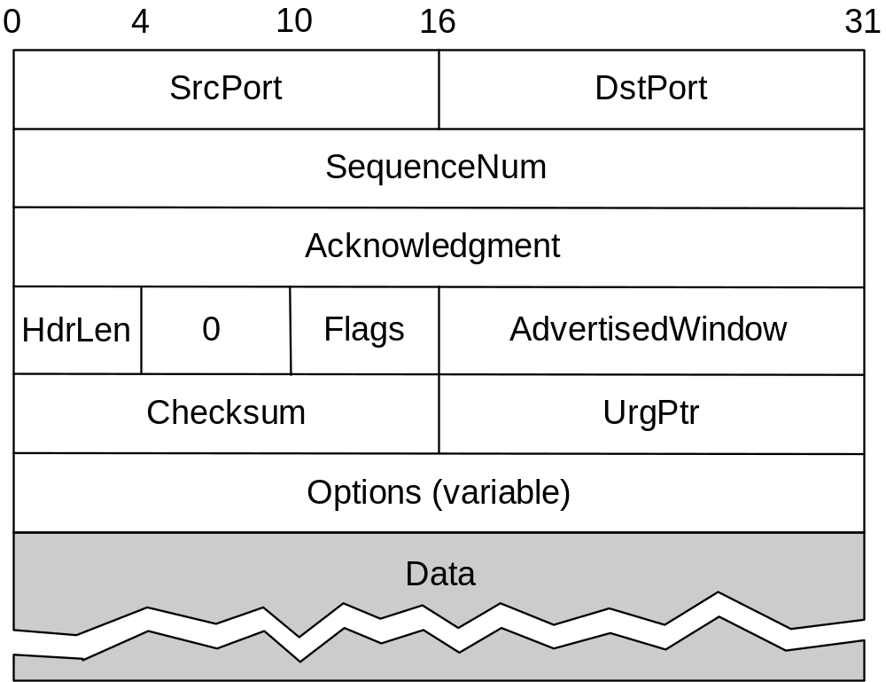
Segment Format

Slide 7
Segment Format (cont)
Each connection identified with 4-tuple:
  (SrcPort, SrcIPAddr, DsrPort, DstIPAddr)
Sliding window + flow control
  acknowledgment, SequenceNum, AdvertisedWinow
Flags
  SYN, FIN, RESET, PUSH, URG, ACK
Checksum
  pseudo header + TCP header + data
Data
(SequenceNum)
Sender
Receiver
Acknowledgment +
AdvertisedWindow

Slide 8
Connection Establishment and Termination
Active participant
Passive participant
(client)
(server)
SYN, SequenceNum =
x
y
,
SYN + ACK, SequenceNum =
+
1
x
Acknowledgment =
ACK, Acknowledgment =
y
+
1

Slide 9
State Transition Diagram
CLOSED
Active open
/SYN
Passive open
Close
Close
LISTEN
SYN/SYN + ACK
Send/
SYN
SYN_RCVD
SYN/SYN + ACK
SYN_SENT
ACK
SYN + ACK/ACK
Close
/FIN
ESTABLISHED
Close
/FIN
FIN/ACK
FIN_WAIT_1
CLOSE_WAIT
FIN/ACK
ACK
Close
/FIN
FIN_WAIT_2
ACK + FIN/ACK
CLOSING
LAST_ACK
ACK
Timeout after two
ACK
FIN/ACK
segment lifetimes
TIME_WAIT
CLOSED

Slide 10
Sliding Window Revisited
Sending application
Receiving application
TCP
TCP
LastByteWritten
LastByteRead
LastByteAcked
LastByteSent
NextByteExpected
LastByteRcvd
Sending side
  LastByteAcked < = LastByteSent
  LastByteSent < = LastByteWritten
  buffer bytes between LastByteAcked and LastByteWritten
Receiving side
  LastByteRead < NextByteExpected
  NextByteExpected < = LastByteRcvd +1
  buffer bytes between NextByteRead and LastByteRcvd

Slide 11
Flow Control
Send buffer size: MaxSendBuffer
Receive buffer size: MaxRcvBuffer
Receiving side
  LastByteRcvd - LastByteRead < = MaxRcvBuffer
  AdvertisedWindow = MaxRcvBuffer - (NextByteExpected - NextByteRead)
Sending side
  LastByteSent - LastByteAcked < = AdvertisedWindow
  EffectiveWindow = AdvertisedWindow - (LastByteSent - LastByteAcked)
  LastByteWritten - LastByteAcked < = MaxSendBuffer
  block sender if (LastByteWritten - LastByteAcked) + y > MaxSenderBuffer
Always send ACK in response to arriving data segment
Persist when AdvertisedWindow = 0

Slide 12
Protection Against Wrap Around
32-bit SequenceNum
Bandwidth Time Until Wrap Around
T1 (1.5 Mbps) 6.4 hours
Ethernet (10 Mbps) 57 minutes
T3 (45 Mbps) 13 minutes
FDDI (100 Mbps) 6 minutes
STS-3 (155 Mbps) 4 minutes
STS-12 (622 Mbps) 55 seconds
STS-24 (1.2 Gbps) 28 seconds

Slide 13
Keeping the Pipe Full
16-bit AdvertisedWindow
Bandwidth Delay x Bandwidth Product
T1 (1.5 Mbps) 18KB
Ethernet (10 Mbps) 122KB
T3 (45 Mbps) 549KB
FDDI (100 Mbps) 1.2MB
STS-3 (155 Mbps) 1.8MB
STS-12 (622 Mbps) 7.4MB
STS-24 (1.2 Gbps) 14.8MB

Slide 14
TCP Extensions
Implemented as header options
Store timestamp in outgoing segments
Extend sequence space with 32-bit timestamp (PAWS)
Shift (scale) advertised window

Slide 15
Adaptive Retransmission
(Original Algorithm)
Measure SampleRTT for each segment/ ACK pair
Compute weighted average of RTT
  EstRTT = α x EstRTT + β x SampleRTT
  where α + β = 1
  α between 0.8 and 0.9
  β between 0.1 and 0.2
Set timeout based on EstRTT
  TimeOut = 2 x EstRTT

Slide 16
Karn/Partridge Algorithm
Sender
Receiver
Sender
Receiver
Original transmission
Original transmission
TT
TT
Retransmission
ACK
SampleR
SampleR
Retransmission
ACK
Do not sample RTT when retransmitting
Double timeout after each retransmission

Slide 17
Jacobson/ Karels Algorithm
New Calculations for average RTT
Diff = SampleRTT - EstRTT
EstRTT = EstRTT + (δ x Diff)
Dev = Dev + δ( |Diff| - Dev)
  where δ is a factor between 0 and 1
Consider variance when setting timeout value
TimeOut = μ x EstRTT + φ x Dev
  where μ = 1 and φ = 4
Notes
  algorithm only as good as granularity of clock (500ms on Unix)
  accurate timeout mechanism important to congestion control (later)

